Slide 1
Boosting Your Brand the Easy Way
Automating Your Social Media Presence
Jennifer Bene, USA Today Bestselling Author
http://jenniferbene.com

Slide 2
The Rule of Seven
7
Readers need to see your name and your marketing seven times before they take action.
Well, at least seven.
So… why don’t they check out your book the first time they see it?
Notes:
[click] The Rule of Seven is an old marketing adage. It says that when you’re trying to market something a potential customer needs to see or hear your marketing message at least seven times before they take action and buy from you.
[click] Now the number seven isn’t cast in stone. The truth of the Rule of Seven is you can’t just engage in a single marketing activity (a single post, a single tweet) and then be done. Marketing must be an on-going process in order for it to be successful, which can take a lot of time.
[click] But why do potential readers need to hear your message so many times before taking action?

Slide 3
Social Media is Noisy
Facebook and Twitter are filled with lots of people posting — just like you!
“They’re just another author.”
The hard truth? No one is looking for you!
Notes:
[click] In today’s world, people are being bombarded with messages on social media constantly. It’s truly difficult to get past all this noise and be heard, sometimes it’s even hard to show up in their FB timeline or their Twitter feed!
[click] The first few times someone sees your message it’s likely it won’t completely register with them. We all have marketing blinders we’ve built up over time – otherwise we’d be overwhelmed with the constant noise from people clamoring to be heard. So, when they see you posting about a book, and they don’t immediately recognize your name, you’re “just another author” in their social media world. They don’t know that readers like you, they don’t know the quality of your books, and they don’t that you may write just the kind of books they love!
[click] But here’s the hard truth, even if you write the exact kind of books they love, they’re not sitting around waiting for you to show up. They’re busy living their lives, reading the authors they ALREADY know, and you may not even be a blip on their radar, especially if you’re trying to expand your current audience to reach more fans of your particular genre.

Slide 4
How Do You Break Through the Noise?
Get your books out there!
Don’t be repetitive.
Your backlist is gold — so don’t ignore it.
If people like your genre, why not show them all you’ve got?
The secret of the Rule of Seven.
Notes:
So, how do you break through all that noise? How do you get those potential readers to recognize your name, your brand, and check out your books so they can fall in love with you and make you one of their 1-click favorites?
[click] You have to get your books out there! Often we post about our new releases pretty well, especially during release week, but then we stop. We get busy, we start writing our new book, and we stop. Sometimes we even stop posting because we think we’ll annoy our readers, but the rule of seven tells us that those NEW customers, those NEW readers, need to see it over and over before they click.
[click] But, don’t be repetitive. People are smart, and if they start to see the exact same language over and over THAT will annoy them. Hearing from you isn’t irritating, they clicked that hashtag, or follow you on social media for a reason, but hearing the same thing again and again is obnoxious. Also, it draws attention to the fact that you’re not really posting it, which actually hurts your brand. You’ve probably felt this yourself. When we’re watching TV, or streaming shows with commercials, brands show up over and over with the same freaking commercial. The first couple of times it might hold your attention, but the 5th time you see that same car insurance commercial you’re probably rolling your eyes and checking Facebook just to avoid staring at it.
[click] Did you know that most successful authors make a good portion of their monthly income from their backlist? It’s true! Your backlist is gold, and the worst thing we do in marketing on social media is completely forget about it. We do those new release posts, and then we just… let our books fade. BUT WHY?
[click] If people like your genre, showing them a more diverse set of books is going to grab their attention faster than anything else!
[click] And really, that’s the secret behind the Rule of Seven. As they’re scrolling Twitter and Facebook, the first few times they see your name pop up they have that reaction I talked about. “Oh look, another author” and then they move on. But, if they scroll past your name five, ten, twenty times, their brain starts to remember your name, your brand, and it’s going to make them pause. Because why would they recognize your name if you weren’t popular? Why would they remember it if other people in their social media universe weren’t fans of you? Even if you AREN’T that popular yet, you can use the rule of seven to get people to believe you are.
It’s probably happened to you as well, because we all follow the other authors and readers of our genres. An author that was a total unknown to you two years ago, now may be the person that you wish you could be like. That person could be making fifty grand a month, or five hundred dollars, but your perception is what matters to their brand. If you believe they are popular / successful / etc. then you’re more likely to check out their books, and maybe even fall in love with them.
Don’t you want that too?

Slide 5
But that takes so much time!
The only problem? We’re busy too.
Automate your social media presence.
Social Jukebox
Hootsuite
Linking your social media together
Notes:
[click] If we had infinite amounts of time, none of this would be a problem. But just like our readers are busy SO ARE WE! We need to actually write the books that we want to sell. Many of us have day jobs, and families, and other responsibilities, which means we can’t just sit there and post new, fresh content twenty-four hours a day.
[click] That’s what I’m here to talk to you about today, and I’m so excited to share some of the cool things I’ve learned to help you boost your brand without spending all your time on it. Automating your social media presence is like magic, because it takes care of the rule of seven for you and gets you in front of all those readers you want to reach
There’s a few awesome resources I want to share and teach you how to maximize your return on investment with them.
[click] Social Jukebox
[click] Hootsuite
[click] and linking your social media accounts together so you get more out of the work you put in!
Let’s get started.

Slide 6
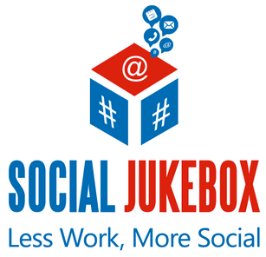
Social Jukebox
Social Jukebox puts Twitter on easy mode.
Create tweets once, and use them forever!
Make Twitter work for you —
more tweets
more interactions
Twitter algorithm
more visibility
Notes:
First, I want to talk to you about Social Jukebox.
[click] This website puts Twitter on easy mode. Twitter can be exhausting because there is so much content coming out constantly that it’s even harder to break through the noise, but the good news is that readers who use Twitter actually click on hashtags and search, and the more people you follow (and follow you) within your genre, the farther your reach grows.
[click] The best part is that you only have to create tweets ONE TIME, and then you can use them forever.
[click] And it makes Twitter work for YOU. [click] The more often you tweet > [click] the more interactions you get > [click] the more the Twitter algorithms favor you > [click] the more people see you. It becomes a beneficial cycle… but you have to post enough for it to happen.

Slide 7
Step One: Make the tweets
It takes time, but it’s worth the investment.
Start with your new release, then work backward.
Make 10 – 12 tweets about your book (quotes, reviews, taglines, attention grabbers, different hashtags).
Graphics make a difference.
Don’t just post about books.
Notes:
[click] Making the tweets is the most time consuming part of this process, I promise. Everything after this step is pretty easy, but it is absolutely worth the upfront investment, and the good news is you don’t have to do it all at once. You could do it over the next six months, and you would still start getting the benefit.
[click] Start with your new release, and then work on your backlist. After all, you’re more likely to snag your current readers attention with the newest book you’ve released, and we don’t want to forget about them!
[click] One of the biggest mistakes authors make is they post the same 2 or 3 tweets all the time, and we already talked about what happens when we do that. We irritate people into not paying attention to it! So, I recommend ten to twelve tweets minimum for each book. The good news is there’s a variety of kinds of tweets you can write, especially now that we have 280 characters.
Take some of the hottest or most intriguing quotes from your book and use those! Have an awesome review? Quote them, and use the reviewer’s Amazon or Goodreads name in the tweet (if they see it, they’re probably going to retweet it!).
Post with your taglines, or attention grabbing language. Sometimes mystery sells better than anything else. Don’t just tell the reader about your book, talk about it. An example? “Bad boys do it better” says nothing about a particular book, but would grab the attention of a reader who likes to read about bad boys. Then you can use hashtags, a picture of a hot guy, and bam! You’re attracting clicks to your book because they want to know what book it’s talking about!
And play with hashtags. Don’t use the same set for every tweet about the same book. Check out other tweets about books in your genre and steal their hashtags! Pay attention to your Twitter notifications and see which hashtags get more responses and use those more often.
[click] Try to always include a graphic. On a Twitter timeline, tweets with a graphic take up more real estate on the screen, so someone is more likely to pause and read your tweet, especially if that image is visually engaging. And remember, it doesn’t always have to be a hot guy. It can be a couple kissing while clothed, it can be an object related to your genre. Anything that will catch their attention is a great idea, and while you should definitely use your cover sometimes, don’t use it in every tweet because it does the same thing as using the same language. They see the SAME COVER and think they’ve already read the tweet. Grab their attention in new ways with each tweet, and you’ll get more interactions.
[click] Finally, don’t JUST post about books. There are lots of different things you can do, and I’ll talk about some of those on the next slide.

Slide 8
Step Two: Build Your Jukeboxes
Notes:
These are the jukeboxes I use, and I’ll tell you why.
[click] New Release – This is probably where you’re going to start, because like I said before it’s the book you want to get the most attention on right now. I only have 41 tweets in this one, because I screenshotted it when I was advertising a boxset, so I didn’t just have tweets about my story, but everyone’s! TIP: When you’re in a boxset, write tweets for the other authors’ stories and TAG THEM. They will likely favorite it and retweet it, which makes their readers see your name + associate you with an author they already like! Plus, it helps out the whole boxset.
[click] Backlist – Remember when I said the Backlist is gold? It is, and we want to draw readers in to our whole offering of books. Maybe one storyline attracts a reader over another, and you get the bonus of having a much more diverse feed on Twitter. I’ll talk about how you make the posts go out at different times in a second. Now, it took me MONTHS to build up my backlist jukebox. I definitely didn’t do this overnight, but now I have a huge volume of tweets for Social Jukebox to pull from that keeps my older books in the feeds of my readers.
[click] Short-term Promo – You know how you sign-up to participate in a giveaway, or attend an event, or whatever and you’re supposed to remember to post about it? Yeah, I admit that before Social Jukebox there were times I maybe posted once about it, if I was lucky enough to remember. Having this jukebox separated out lets you put tweets about signings you’re attending, giveaways, events, etc. that need to be posted about. I also have a few tweets about my newsletter, my website, my FB group, following me on Bookbub / Facebook / Goodreads, and it just keeps those random items top of mind. Now, I also write blogs on my website about BDSM in real-life, and since I started putting links to those in my short-term promo jukebox, my website visits, comments, and clicks have gone WAY up. So, if you do something unique somewhere on the interwebz, put tweets about it here!
[click] On the last slide I talked about not just posting about books. That’s why I have a jukebox called “Tips and Inspiration for Writers”. Every time I find one of those inspirational pics on Instagram, or Pinterest, or FB I save it to a folder on my desktop and then the next time I get around to it I add them into this jukebox with some applicable hashtags. This has connected me to more awesome authors and readers than I think anything else, because I’m not trying to sell them something. Then, when they follow me, they see my book posts and are more likely to click through. This is another jukebox that you could build over years, but you’d start reaping the benefits right away!
Now, you can make as many jukeboxes as you want, for as many topics as you want, but there is a benefit to having fewer jukeboxes and just filling them with what you want to share. To understand that, let’s talk about scheduling.

Slide 9
Step Three: Schedule Your Tweets
Notes:
This is where the magic happens, scheduling your tweets to be sent out automatically by social jukebox throughout the week. You have to schedule each jukebox separately, but it really doesn’t take much time.
First, click on the jukebox you want to schedule.
[click] Then, on the jukebox screen, click on the schedule tab.

Slide 10
Step Three: Schedule Your Tweets
Notes:
The schedule screen lets you be really specific about what days, what time ranges, and how often your tweets go out, and the interface is pretty easy to use!
First, decide when you want it to go out. What I do is alternate between backlist days, and new release days, so that I’m not always posting about the same books.
[click] For my backlist, I do Tuesday, Wednesday, Friday, and Sunday. I post more frequently about backlist books because I have a lot of tweets now so the posts are more diverse, and I don’t wear out my followers talking about my new release every single day. You make those decisions by turning days on and off.
[click] Then, I figure out what time range I want to be tweeting. I could post twenty-four hours a day, but I know that 90% of my income is from US sales, so “wasting” tweets from my jukebox in the middle of the night isn’t really going to help me. So, for this jukebox I do from 6am central time, to midnight. Other jukeboxes I have post earlier, and my author inspiraton I let it run 24 hours to catch authors around the world.
[click] Finally, I fill out the frequency I want social jukebox to send out posts. You want to do these at WEIRD time intervals, because otherwise you’re posting EVERY DAY at the same time. This can get you flagged as a spammer pretty easy, so doing weird times helps out. Also, it helps you hit new readers because it’s always counting from your start time.
[click] Once you’ve done this for all your jukeboxes, you can see how you did on the visual schedule (which I love!)

Slide 11
Step Three: Schedule Your Tweets
Notes:
When you click on Visual Schedule, it will show you the full 24 hour timeline of your jukeboxes, with each of them set out based on the time ranges, and frequency of each jukebox.
[click] This is the best way to check and see if you’re posting all at the same time, or if you’ve got a good scatter of post times.
[click] If you see a problem on this screen, go back and tweak the schedule, and then return to the visual schedule to see how you did!

Slide 12
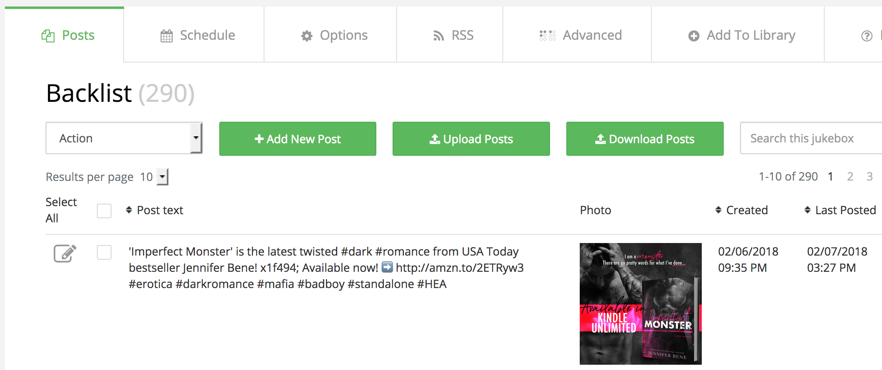
Step Four: Avoid Repetition
Notes:
Now that we have an awesome schedule for all of our tweets, we want to make sure we’re not being too repetitive. This forces Social Jukebox to use ALL your tweets in your library instead of using the same one over and over.
[click] To do this, back in your jukebox screen click on the Options tab.

Slide 13
Step Four: Avoid Repetition
Choose based on the number of tweets in that particular jukebox.
Do this for each jukebox!
Sit back and enjoy your automated Twitter feed.
Notes:
Once you’re there, you really don’t want to mess with any of the settings in here except for the repetition.
[click] Based on the number of tweets in your jukebox, you’ll want to choose the number of days it won’t repeat a post. Just remember, especially when you’re first starting out, if this number is too high then Social Jukebox won’t post at all because it has to wait until it can repeat a tweet!
[click] Make sure you set this for each jukebox.
[click] Then it’s time to sit back and enjoy your Twitter feed! You’ll have increased presence on Twitter all the time, and be marketing your new releases and your backlist every day of the year. How awesome is that?

Slide 14
Twitter, Meet Facebook
Connect Twitter to your Author Facebook Page!
Facebook algorithm changes make Pages almost obsolete, but sometimes posts make it onto the timeline.
Keeps your Author Facebook Page updated in case a reader looks for you there!
Notes:
Now that you’ve put all this work into getting Twitter updating all the time, we might as well make the most of it, right?
[click] You can connect Twitter to your Author Facebook Page so that all of your tweets get posted to it. I’m going to show you how to do that in a second, but first I want to talk about why you don’t want this on your normal profile page. With all of the tweets we just setup, you’d completely obliterate your normal author profile with these.
[click] But, since the Facebook algorithms have decimated the ability for “pages” to get seen on Timelines, it really doesn’t pay to spend time putting real content on there. However, you also don’t want readers on Facebook to search for you and find a “dead” author page.
[click] Connecting your Twitter acct to your Facebook Author Page keeps it updated in case someone looks for you there, but it doesn’t take any extra time for you, and on the FB side it doesn’t matter much since Facebook has made it almost impossible to get page content in front of your readers anyway. Any of the tweets that do get seen are just bonus advertising / social media presence!

Slide 15
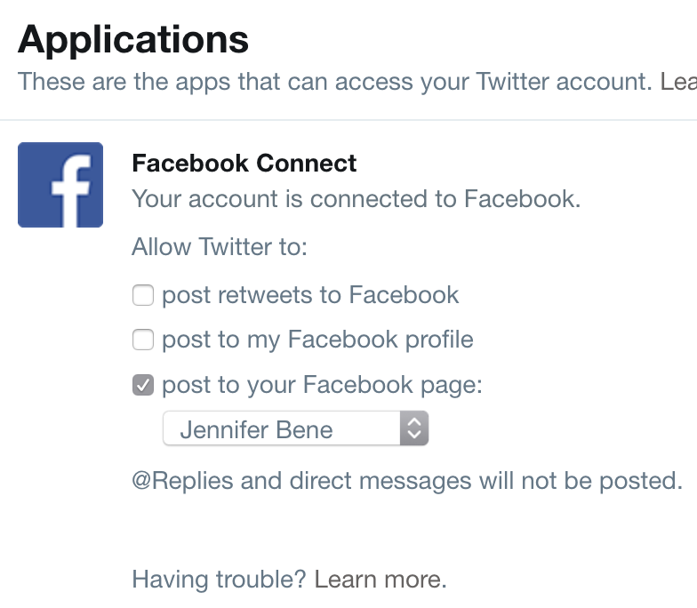
Twitter, Meet Facebook
Under Twitter settings, choose the Apps tab.
Connect Facebook.
Select only “Post to Your Facebook Page” and choose your author page from the drop down menu.
Notes:
Now that you’ve put all this work into getting Twitter updating all the time, we might as well make the most of it, right?
[click] You can connect Twitter to your Author Facebook Page so that all of your tweets get posted to it. I’m going to show you how to do that in a second, but first I want to talk about why you don’t want this on your normal profile page. With all of the tweets we just setup, you’d completely obliterate your normal author profile with these.
[click] But, since the Facebook algorithms have decimated the ability for “pages” to get seen on Timelines, it really doesn’t pay to spend time putting real content on there. However, you also don’t want readers on Facebook to search for you and find a “dead” author page.
[click] Connecting your Twitter acct to your Facebook Author Page keeps it updated in case someone looks for you there, but it doesn’t take any extra time for you, and on the FB side it doesn’t matter much since Facebook has made it almost impossible to get page content in front of your readers anyway. Any of the tweets that do get seen are just bonus advertising / social media presence!

Slide 16
Questions on Social Jukebox?
Notes:
What questions do you have on Social Jukebox?
[answer questions as appropriate, then transition to discussing hootsuite]

Slide 17
Notes:
Let’s talk about one other resource that I think could help you for those one-off situations. Hootsuite.

Slide 18
Hootsuite
Release days, contests, and everything else!
Share content on a specific day / time
Post across multiple accounts with one click
Notes:
[click] Hootsuite is for release days, contests, and everything else!
[click] Have you ever wanted to schedule social media content to hit on a certain day or time?
[click] You can pre-write blog posts or social media posts, and get them to your readers when you want them to see it across multiple accounts with just one click

Slide 19
Hootsuite
Connect all of your social media accounts in one place
Type one message to go out on all of them, or customize for each!
Free up to 30 scheduled posts at a time
Notes:
[click] Connect all of your social media accounts in one place
[click] Type one message to go out on all of them, or customize for each! You can do separate hashtags, separate images, etc!
[click] Free up to 30 scheduled posts at a time.

Slide 20
Questions on Hootsuite?
Notes:
What questions do you have on Hootsuite?

Slide 21
Contact Jennifer Bene
Still have questions? Need help?
I believe that when we help each other be great in authorlandia, we all benefit, so I will never charge for things like this. If I can help you, I will, and so this presentation (and any other authory things) will never cost money. If you find this content for sale anywhere, please contact me immediately! Thank you, lovelies, and reach out with any questions!
jbeneauthor@gmail.com

